Slide 1
Testing Unit-IV
Prepared by: Neha Tripathi

Slide 2
Testing
Lecture-2

Slide 3
White Box Testing
One white-box testing strategy is said to be stronger than another strategy, if all types of errors detected by the first testing strategy is also detected by the second testing strategy, and the second testing strategy additionally detects some more types of errors.
When two testing strategies detect errors that are different at least with respect to some types of errors, then they are called complementary.

Slide 4
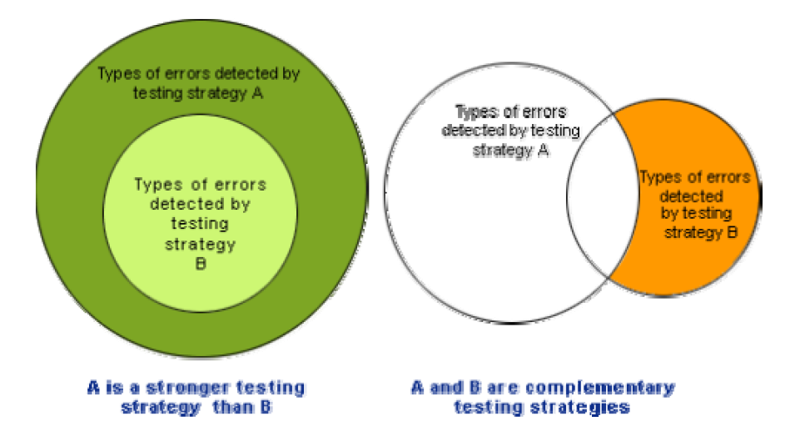
Stronger and complementary testing strategies

Slide 5
Test case design using white-box approach
Following are the two main approaches to design white box test cases:
- Statement coverage
- Branch coverage
- Condition coverage
- Path coverage
- MaCabe’s cyclomatic complexity V(G)

Slide 6
Statement Coverage
The statement coverage strategy aims to design test cases so that every statement in a program is executed at least once.
Main Aim : unless a statement is executed, it is very hard to determine if an error exists in that statement.
Failure of statement could be caused due to –illegal memory access, wrong result computation, etc.
However, executing some statement once and observing that it behaves properly for that input value is no guarantee that it will behave correctly for all input values.

Slide 7
Example:
Consider the Euclid’s GCD computation algorithm:
int compute_gcd(x, y)
int x, y;
{
1. while (x! = y){
2. if (x>y) then
3. x= x – y;
4. else y= y – x;
5 }
6 return x;
}
By choosing the test set {(x=3, y=3), (x=4, y=3), (x=3, y=4)}, we can exercise the program such that all statements are executed at least once.

Slide 8
Branch Coverage
In this test cases are designed to make each branch condition to assume true and false values in turn.
Branch testing is also known as edge testing as in this testing scheme, each edge of a program’s control flow graph is traversed at least once.
NOTE : Branch testing guarantees statement coverage and thus is a stronger testing strategy compared to the statement coverage-based testing.
For Euclid’s GCD computation algorithm , the test cases for branch coverage can be {(x=3, y=3), (x=3, y=2), (x=4, y=3), (x=3, y=4)}.

Slide 9
Condition Coverage
In this structural testing, test cases are designed to make each component of a composite conditional expression to assume both true and false values.
Example : ((c1 and c2) or c3)
NOTE : Condition testing is a stronger testing strategy than branch testing and branch testing is stronger testing strategy than the statement coverage-based testing.
For a composite conditional expression of n components, for condition coverage, 2ⁿ test cases are required. Thus, for condition coverage, the number of test cases increases exponentially with the number of component conditions. Therefore, a condition coverage-based testing technique is practical only if n (the number of conditions) is small.

Slide 10
Path Coverage
The path coverage-based testing strategy requires us to design test cases such that all linearly independent paths in the program are executed at least once.
A linearly independent path can be defined in terms of the control flow graph (CFG) of a program.
CFG : It describes the sequence in which the different instructions of a program get executed. It basically describes the control flows through the program.

Slide 11
Control Flow Graph (CFG)
A control flow graph describes the sequence in which the different instructions of a program get executed.
In other words, a control flow graph describes how the control flows through the program.
In order to draw the control flow graph of a program, all the statements of a program must be numbered first. The different numbered statements serve as nodes of the control flow graph
An edge from one node to another node exists if the execution of the statement representing the first node can result in the transfer of control to the other node.
The CFG for any program can be easily drawn by knowing how to represent the sequence, selection, and iteration type of statements in the CFG

Slide 12
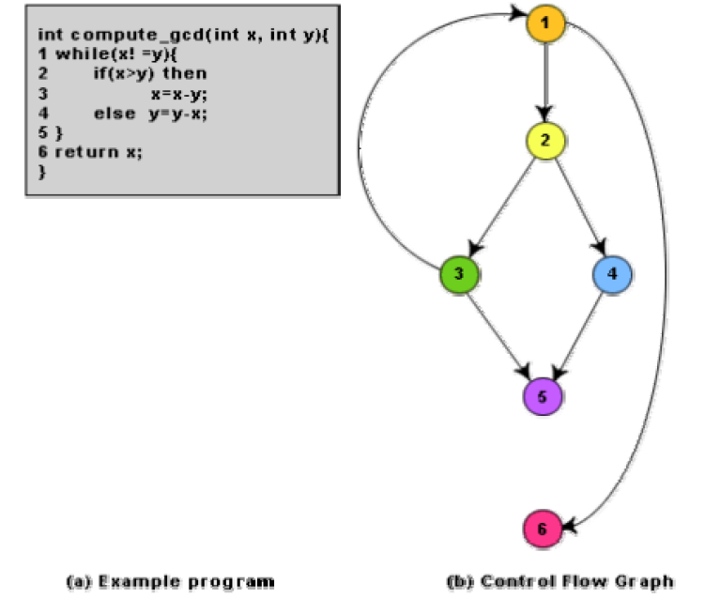
Control flow diagram

Slide 13
Path
A path through a program is a node and edge sequence from the starting node to a terminal node of the control flow graph of a program.
There can be more than one terminal node in a program.
Writing test cases to cover all the paths of a typical program is impractical.
For this reason, the path-coverage testing does not require coverage of all paths but only coverage of linearly independent paths.

Slide 14
Linearly Independent Path
Any path through the program that introduces at least one new edge that is not included in any other linearly independent paths.
If a path has one new node compared to all other linearly independent paths, then the path is also linearly independent.
NOTE : Path-coverage testing does not require coverage of all paths but only coverage of linearly independent paths.

Slide 15
McCabe’s Cyclomatic Complexity
It defines an upper bound for the number of linearly independent paths through a program.
It provides a practical way of determining the maximum number of linearly independent paths in a program.
NOTE : This does not directly identify the linearly independent paths, but informs approximately how many paths to look for.

Slide 16
Ways to compute Cyclomatic complexity
There are three different ways to compute the cyclomatic complexity. The answers computed by the three methods are guaranteed to agree.
METHOD 01 :
Given a control flow graph G of a program, the cyclomatic complexity V(G) can be computed as:
V(G) = E –N + 2
N is the number of nodes of the control flow graph
E is the number of edges in the control flow graph.

Slide 17
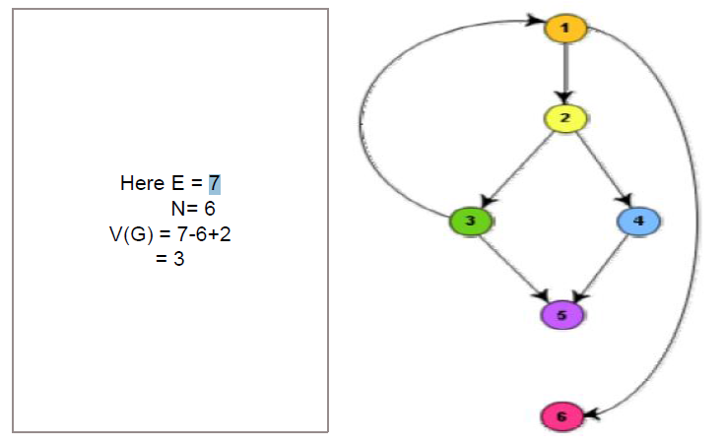
Example of Method 01

Slide 18
continue…..
METHOD 02 :
Inspect the control flow graph
V(G) = Total number of bounded areas + 1
V(G) = 2+1
= 3
NOTE : any region enclosed by nodes and edges can be called as a bounded area.

Slide 19
continue…..
METHOD 03 :
By computing the number of decision statements of the program. If N is the number of decision statement of a program then,
V(G) = N+1
= 2+1
=3

Slide 20
Thank You!

